Slide 1


A rad Application Platform
Introducing
@PalmEmanuel
Notes:
Intro – story about containers, modernization
Raise of hands – Who’s a developer? Who would like to spend less time needing to learn and write templates for Kubernetes, ARM or other IaC, or at least simplify it?

Slide 2
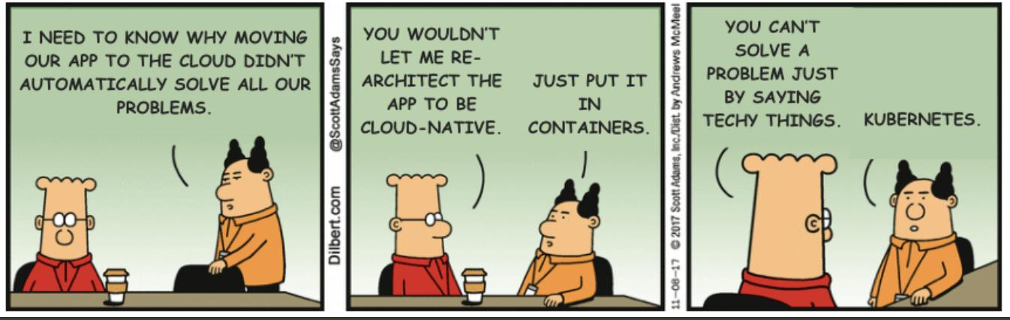

Slide 3




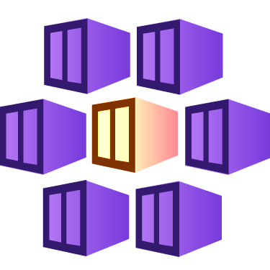


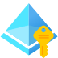





Your App
Key Vault
Kubernetes
Storage
Function
Managed Identity
Notes:
Raise of hands
Is this your application?
No. Kubernetes is not your application.
Is this your application?
Maybe. It has components, identities and integrations outside wherever it resides.

Slide 4
Radius was created to…
… create a common understanding of what an application is
for Developers
for Platform Engineers
for IT Operators
for Security Experts
… support developers
on Kubernetes
on Serverless Platforms in the future
by integrating with existing workflows and tooling…
like Bicep
like Terraform
like Helm charts
like Kubernetes YAML

Slide 5
Appi-ness
the feeling of satisfaction one has when the application is at the center of every workflow

Slide 6

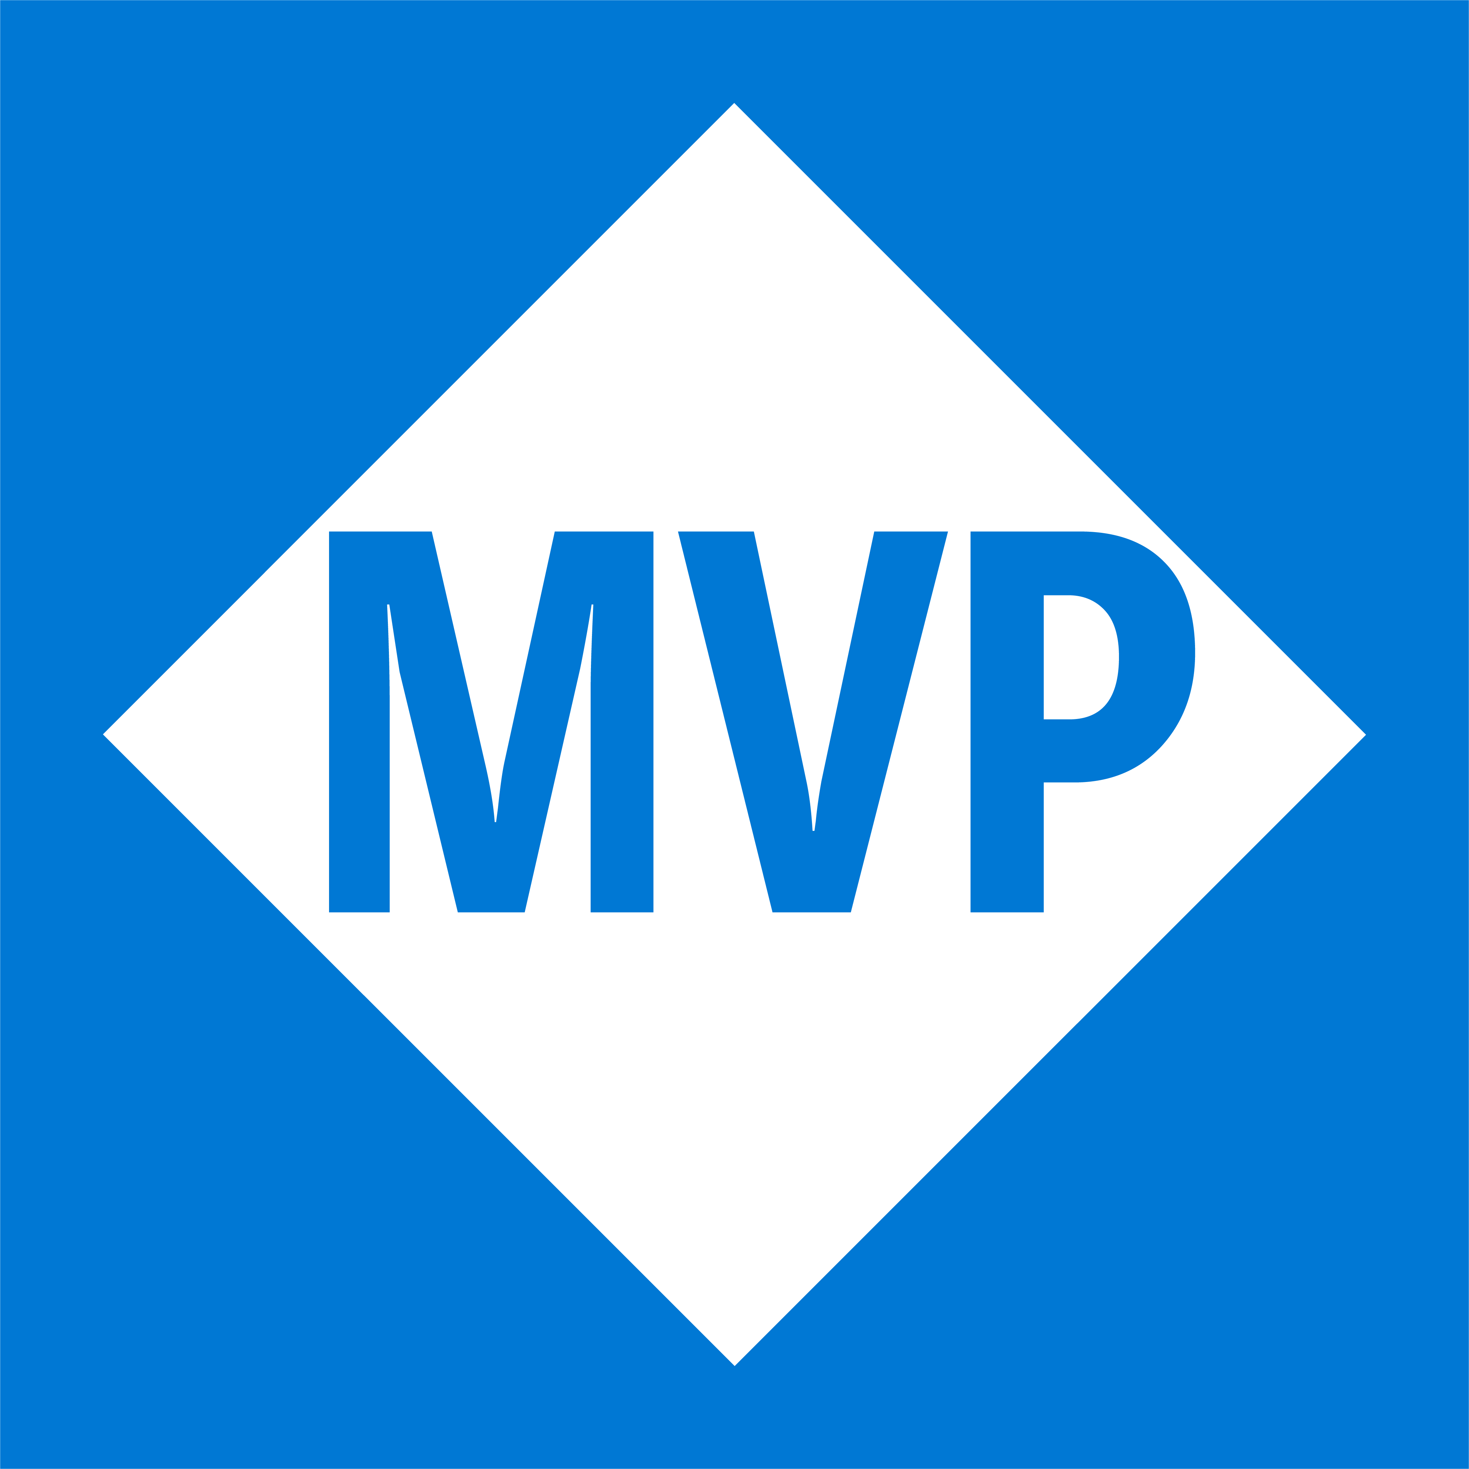
Emanuel Palm
@PalmEmanuel
🧙☕🍰🧗🥏
❤️ Everything-as-Code
📦 Makes modules & tools
📃 Fan of Open Source
☁️ Blogs at pipe.how

Slide 7


Session Overview
1
2
3
Radius?
Demo
Summary & Questions

Slide 8
≠
Remote Authentication Dial-In User Service (RADIUS)

Slide 9
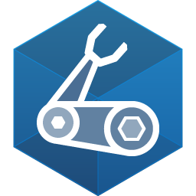
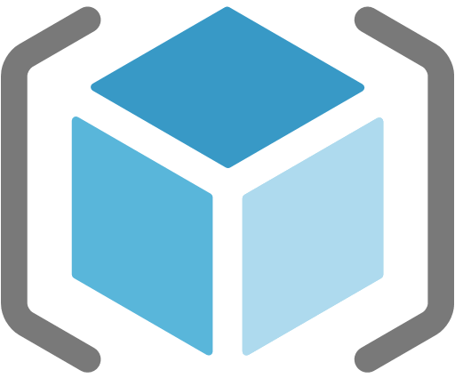
Azure Resource Manager (ARM)
Bicep
Radius

Slide 10


Notes:
Pretty humerus, you could say

Slide 11
Notes:
Pretty humerus, you could say

Slide 12
Where does Radius fit into your organization?
Last section of "Concept: Why Radius": "Developers and platform engineers need to collaborate". Explaining how the different parts of Radius fits into an organization with roles like platform engineers, operators, cloud and security experts, developers.
If your developers want cake, but your organization has an allergy against public access, you can create a recipe to ensure private networking.
In platform engineering, Microsoft talks about paving paths for your organization to make it easier to follow requirements and policies, Recipes can be a way to achieve that
If you have a bunch of apps today

Slide 13
Notes
There is a codespace to get started, or a bunch of alternatives for installation
News since release (0.28 or 0.29 for example)
Upcoming presentation info at https://docs.radapp.io/community/overview/
There’s a roadmap
Currently you can only manage the cluster Radius is installed in, but multi-cluster support is planned

Slide 14
UPC and Component Topography slide with diagrams
Also a layered approach where first we show an environment, and within that (like the Vnet diagram) we see the recipes, and wherever workspaces and resource groups fit into the overview picture. To grasp the concepts

Slide 15
Bicep for Everything
Even AWS through the AWS Cloud Control API
Custom fork at the moment
Terraform works too

Slide 16
rad init
Notes:
Show codespace from VS Code
The anatomy of a template and Recipe
There’s a special VS Code extension (while they fork Bicep)
Deploying to both local environment and Azure
Dashboard sneak peek

Slide 17



Summary (thanks Slidemania)
Radify your apps now
It’s well-documented and open source, and there are monthly community calls.
Promote Appi-ness
Implement tools that allow you to speak the same language in the organization, communication is always 🔑
3
example
radapp.io
aka.ms/radius/discord
github.com/radius-project

Slide 18
Questions
How does Radius compare to X?
https://docs.radapp.io/concepts/faq/#comparison-to-other-tools

Slide 19
Very interesting facts!
This is where you section ends. Duplicate this set of slides as many times you need to go over all your sections.

Slide 20
Thank you!
Do you have any questions?
hello@mail.com
555-111-222
mydomain.com

